Slide 1

4.9 Instruction Processing
31
The fetch-decode-execute cycle is the series of steps that a computer carries out when it runs a program.
We first have to fetch an instruction from memory, and place it into the IR.
Once in the IR, it is decoded to determine what needs to be done next.
If a memory value (operand) is involved in the operation, it is retrieved and placed into the MBR.
With everything in place, the instruction is executed.
The next slide shows a flowchart of this process.

Slide 2
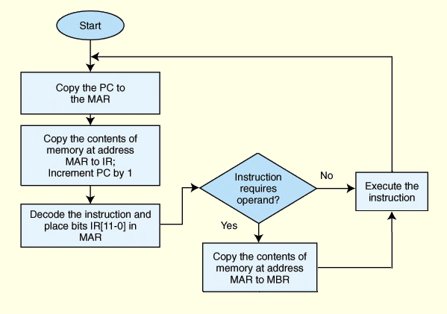
4.9 Instruction Processing
32

Slide 3
4.9 Instruction Processing
32b
The fetch-decode-execute cycle is sometimes called the fetch-decode-fetch-execute cycle.
That’s because after you decode an instruction, you may have to fetch data from one or memory addresses, depending on the format of the instruction.

Slide 4
4.9 Interrupts
33
All computers provide a way of interrupting the fetch-decode-execute cycle.
The normal execution of a program is altered when an event of higher-priority occurs. The CPU is alerted to such an event through an interrupt.
Interrupts may occur when:
  A user break (e.,g., Control+C) is issued
  I/O is requested by the user or a program
  A critical error occurs (e.g., divide by zero)
Interrupts can be caused by hardware or software Software interrupts are also called traps.

Slide 5
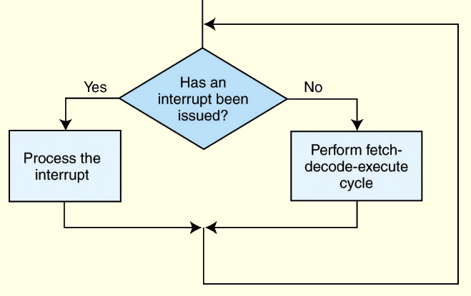
4.9 Interrupts
34
Interrupt processing involves adding another step to the fetch-decode-execute cycle as shown below.
The next slide shows a flowchart for interrupt processing.

Slide 6
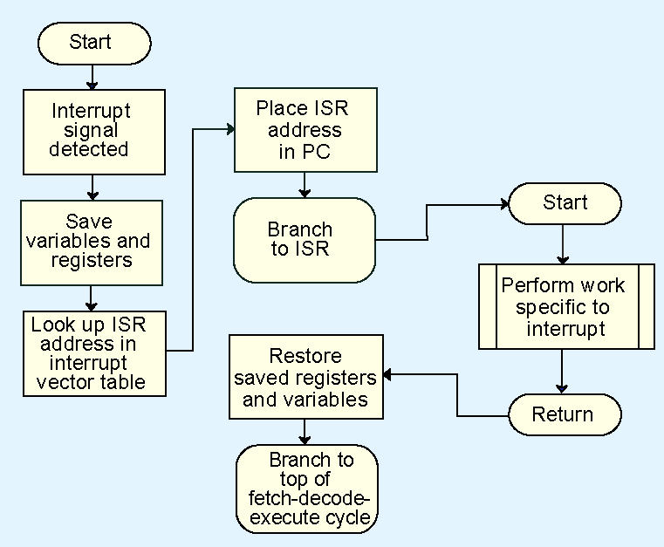
4.9 Interrupts
35

Slide 7
4.9 Interrupts
36
Each interrupt is associated with a procedure that directs the actions of the CPU when an interrupt occurs.
For general-purpose systems, it is common to disable all interrupts during the time in which an interrupt is being processed.
  This is usually achieved by setting a bit in the flags register.
Interrupts that are ignored in this case are called maskable.
Nonmaskable interrupts are high-priority interrupts that cannot be ignored if the system is to continue running.

Slide 8
4.9 MARIE I/O
37
Interrupts are very useful in processing I/O.
  More detail about interrupt-driven I/O can be found in Chapter 7.
MARIE uses a modified form of programmed I/O.
All output is placed in an output register, OutREG, and the CPU polls the input register, InREG, until input is sensed, at which time the value is copied into the accumulator.
  Polling means regular repeated attempts to read.

Slide 9
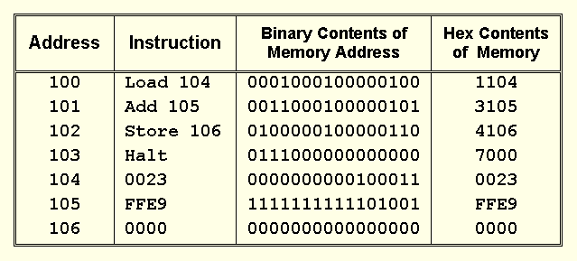
4.10 A Simple Program
38
Consider the simple MARIE program given below. We show a set of mnemonic instructions stored at addresses 100 - 106 (hex):

Slide 10
4.10 A Simple Program
38
Explanation of chart on preceding slide:
  First column: address of that line of program
  Second column: instruction in words
  Third column: instruction encoded in binary
  Fourth column: instruction encoded in hex
Things to notice
  First nibble of instruction is op code; the rest is address
  Op code is 4 bits, so fits in one nibble
  Address is 12 bits, so needs 3 nibbles
  The data in 104 - 106 isn’t important; program will work with any data. Data for Marie is in 2’s complement form.

Slide 11
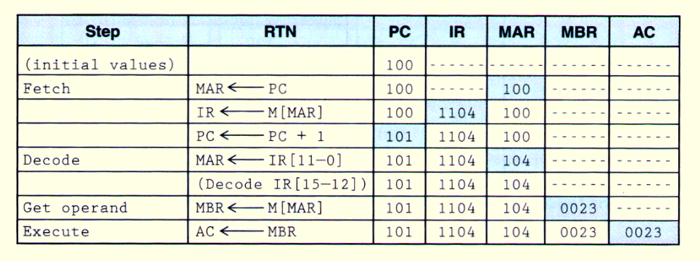
4.10 A Simple Program
39
Let’s look at what happens inside the computer when our program runs. This is the LOAD 104 instruction.
For each line, make sure you understand what happens in each column. Changes are highlighted in blue.

Slide 12
4.10 A Simple Program
39b
RTN = register transfer notation, a synonym for RTL.
The RTN on each line tells you which register is updated and where the new value comes from.

Slide 13
4.10 A Simple Program
39c
.The line in parentheses means that the RTN “branches” according to which instruction was decoded.
That instruction will be executed in the execute step. Here it is the ‘load’ instruction.

Slide 14
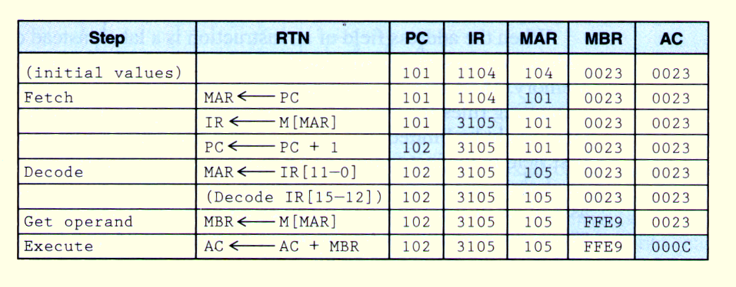
4.10 A Simple Program
40
Our second instruction is ADD 105.
The fetch, decode and “get operand” (i.e., fetch the data) steps are the same.

Slide 15
4.10 A Simple Program
40b
The only thing that is different is the execute, since the instruction is ‘add’ instead of ‘load’.
The AC now has the value of AC + MBR. Remember that MARIE has 2’s complement addition.

